Slide 1


Department of Computer Science and Engineering
Jawaharlal Nehru Technological University Hyderabad University College of Engineering , Science & Technology Hyderabad (Kukatpally, Hyderabad - 500 085, Telangana, India)
Presentation For Dissertation Review – I at Stage – I
Title: Learning-Enhanced Behaviour Trees for Adaptive Non-Player Characters (NPCs)
Presented By:
Talatam Venkata Sandeep
22011P0528
5th Year Integrated Dual Degree (IDP)
Dept. of Computer Science and Engineering
JNTUH UCEST
Mentored By:
Dr. A. Govardhan
Senior Professor of CSE JNTUH
UCESTH and Vice-Chancellor I/c.,
RGUKT Basar.

Slide 2
Abstract
1. Behaviour Trees (BTs) are widely used for NPC decision-making because they are modular, reactive, and interpretable, but conventional BTs have limited ability to adapt to changing game environments and player strategies.
2. Learning-enhanced BTs can improve NPC adaptability by learning which behaviours are more effective based on gameplay experience while retaining the hierarchical structure and designer-defined constraints.
3. This research proposes a lightweight learning-enhanced BT architecture for game NPCs, implemented using C++ and Raylib, and evaluates it against conventional BTs in terms of adaptability, performance, behavioural diversity, and computational overhead.

Slide 3
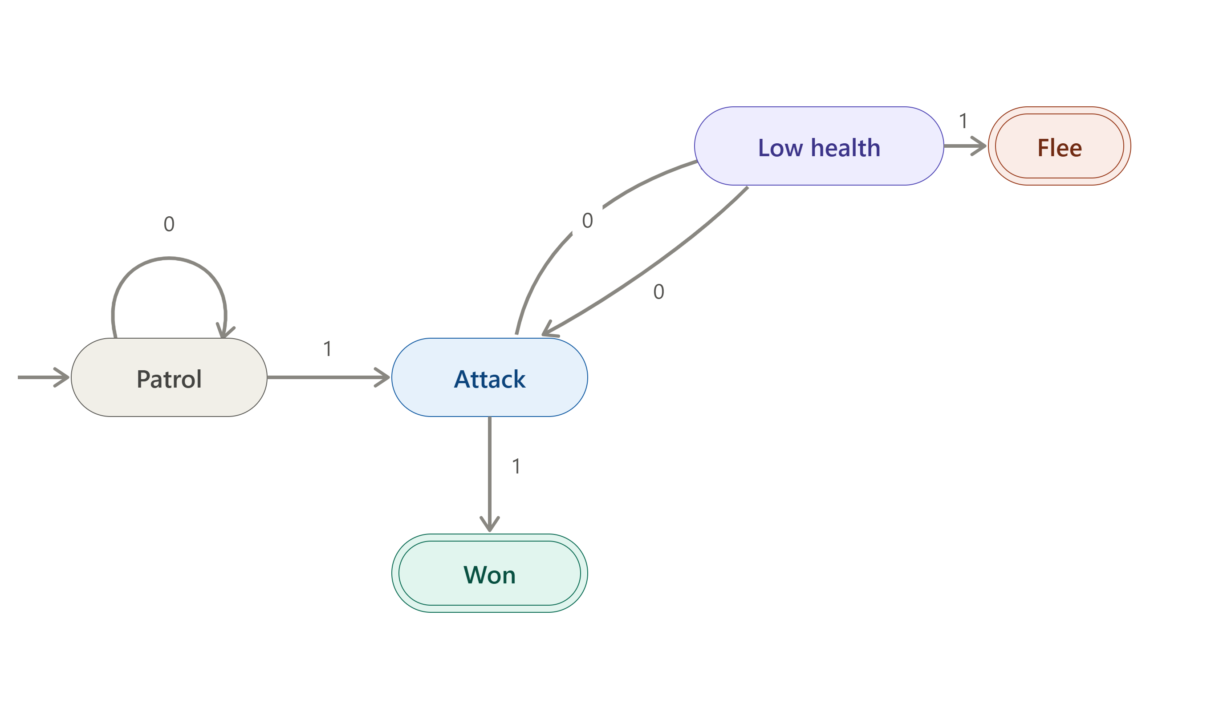
Why? - Finite State Machine
NPC behaviour is represented using a set of predefined states.
The NPC transitions between states based on explicit conditions/events.
Behaviour is primarily rule-driven and manually defined, providing limited adaptation to changing player strategies.

Slide 4
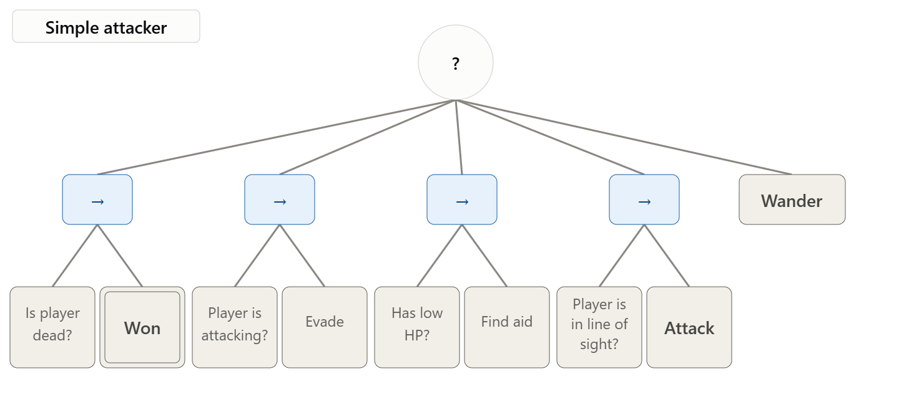
Why? - Conventional Behaviour Tree
Behaviour Trees organize NPC decisions into a hierarchical structure.
Common nodes include:
Selector — chooses an alternative behaviour
Sequence — executes behaviours in order
Condition — checks the game state
Action — performs an NPC behaviour
More modular, reactive, and interpretable than large FSMs.

Slide 5
Existing Work
Selector Adaptation in Behaviour Trees — Hannaford et al. (2016)
Proposed adaptive Behaviour Tree selectors that learn from the outcomes of previously executed behaviours.
The selector changes the execution order of child behaviours based on their observed performance.
Demonstrated that learning-based selector adaptation can improve task performance compared with a fixed behaviour ordering.

Slide 6
Existing Work
Constrained and Adaptive Behaviour-Based Agents — Pereira & Engel (2015)
Proposed integrating Reinforcement Learning (RL) into Behaviour Trees to enable adaptive decision-making.
Learning is performed within the manually designed behaviour structure, rather than completely replacing it.
The approach maintains designer-defined constraints, providing control over the learned behaviour.

Slide 7
Existing Work
Multi-Agent Reinforcement Learning with Behaviour Trees — Li et al. (2024)
Integrated Multi-Agent Reinforcement Learning (MARL) into Behaviour Trees.
Addressed decision-making in complex and dynamic environments involving multiple agents.
Demonstrated that combining MARL with BTs can improve performance while handling unexpected interruptions.

Slide 8
Research Gap
1. Limited focus on game NPCs: Existing learning-enhanced Behaviour Tree approaches largely address robotics and complex multi-agent environments rather than lightweight game NPC applications.
2. Computational overhead: Reinforcement Learning and multi-agent learning can introduce additional training and computational requirements, making them less suitable for resource-constrained game environments.
3. Need for a lightweight adaptive approach: There is a need for a method that improves NPC adaptability while preserving the interpretability, designer control, hierarchical structure, and computational efficiency of conventional Behaviour Trees.

Slide 9
Proposed Work - Learning-Enhanced Behaviour Tree
Player and Game State
Adaptive Selector / Fallback
NPC Action
Gameplay Outcome
Learning-Enhanced Behaviour Tree
Feedback
Develop a Learning-Enhanced Behaviour Tree (LEBT) architecture for adaptive NPC decision-making.
Start with a conventional BT containing behaviours such as Exploration, Pursuit, Evasion, and Combat.
Incorporate a lightweight learning mechanism into selected Selector nodes.
Use environmental and player-state features to estimate which behaviour is more effective in the current situation.
Maintain designer-defined constraints and the hierarchical structure of the BT.

Slide 10
Proposed Work - Implementation & Evaluation
Develop a controlled game environment using C++ and Raylib.
Implement a conventional BT as the baseline and compare it with the learning-enhanced BT.
Allow the NPC to learn behaviour effectiveness from gameplay experience.
Evaluate both approaches using:
Task Success Rate
Adaptation Rate
Behavioural Diversity
Decision Latency
CPU Usage
Robustness to Different Player Strategies
Determine whether lightweight learning can improve NPC adaptability without requiring a fully learning-based controller.

Slide 11
Methodology
Environment Development
Develop a controlled game environment using C++ and Raylib.
Create NPC scenarios involving such as exploration, pursuit, evasion, and combat.
Baseline Behaviour Tree
Implement a conventional designed Behaviour Tree.
Use it as the baseline for comparison.
Learning Integration
Add a lightweight learning mechanism to selected Selector nodes.
Use environmental and player-state features to guide behaviour selection. (Develop another Behaviour Tree of Player for automation)
Constrained Adaptation
Update behaviour selection based on learned experience.
Experimental Evaluation
Measure success rate, adaptation rate, behavioural diversity, decision latency, CPU overhead, and robustness.

Slide 12
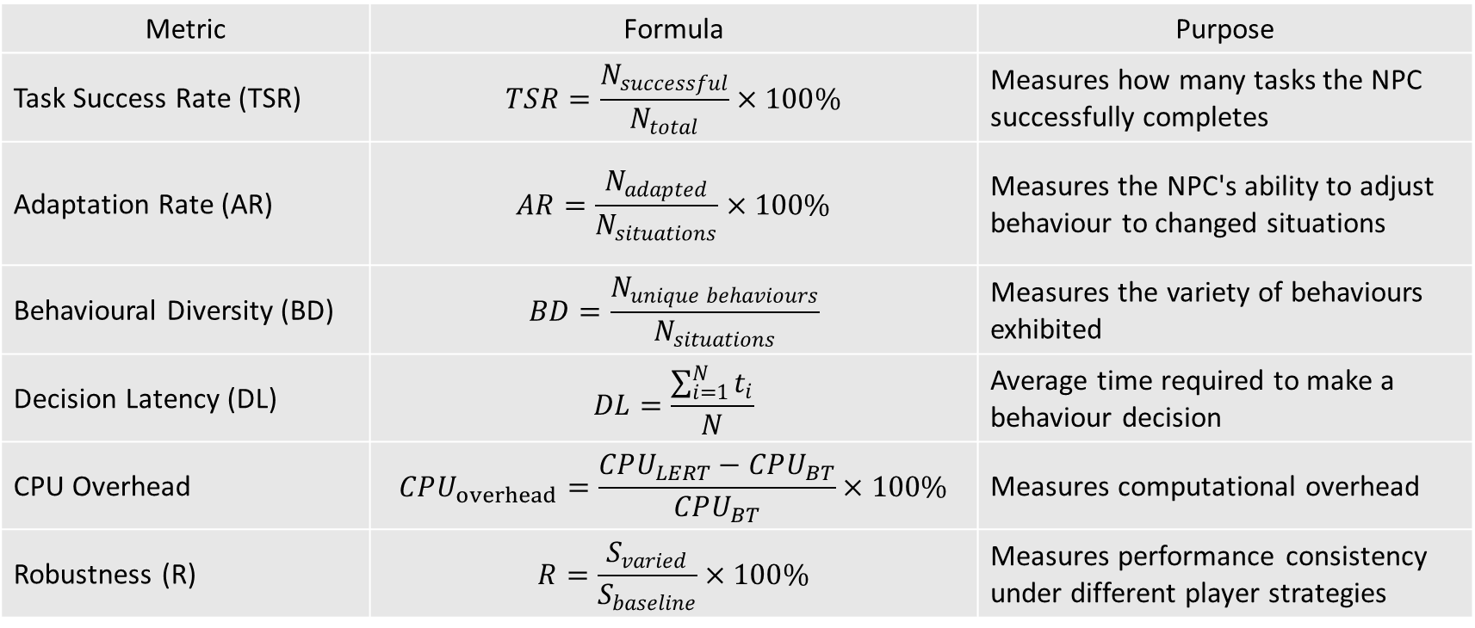
Evaluation Metrics & Formulas
Metric | Formula | Purpose
Task Success Rate (TSR) | $$TSR=\frac{N_{successful}}{N_{total}}×100\%$$ | Measures how many tasks the NPC successfully completes
Adaptation Rate (AR) | $$AR=\frac{N_{adapted}}{N_{situations}}×100\%$$ | Measures the NPC's ability to adjust behaviour to changed situations
Behavioural Diversity (BD) | $$BD=\frac{N_{unique behaviours}}{N_{situations}}$$ | Measures the variety of behaviours exhibited
Decision Latency (DL) | $$DL=\frac{\sum_{i=1}^{N}{t_{i}}}{N}$$ | Average time required to make a behaviour decision
CPU Overhead | $$CPU_{overhead}=\frac{CPU_{LERT}−CPU_{BT}}{CPU_{BT}}×100\%$$ | Measures computational overhead
Robustness (R) | $$R=\frac{S_{varied}}{S_{baseline}}×100\%$$ | Measures performance consistency under different player strategies

Slide 13
REFERENCES
[1] B. Hannaford, D. Hu, D. Zhang, and Y. Li, “Simulation results on selector adaptation in behavior trees,” arXiv preprint arXiv:1606.09219, 2016.
[2] R. P. Pereira and P. M. Engel, “A framework for constrained and adaptive behavior-based agents,” arXiv preprint arXiv:1506.02312, 2015.
[3] X. Li, Y. Li, J. Zhang, et al., “Embedding multi-agent reinforcement learning into behavior trees with unexpected interruptions,” Complex Intelligence Systems, vol. 10, pp. 3273–3282, 2024, doi: 10.1007/s40747-023-01326-7.

Slide 14
Thank You

